Slide 1

Final Project
Diagnostic potential for a serum miRNA
neural network for detection of ovarian
cancer
Members : 章峻福 110753503
葉冠宏 108753208

Slide 2
1
What is this paper talking about
2
The key point what we got
3
Our results

Slide 3
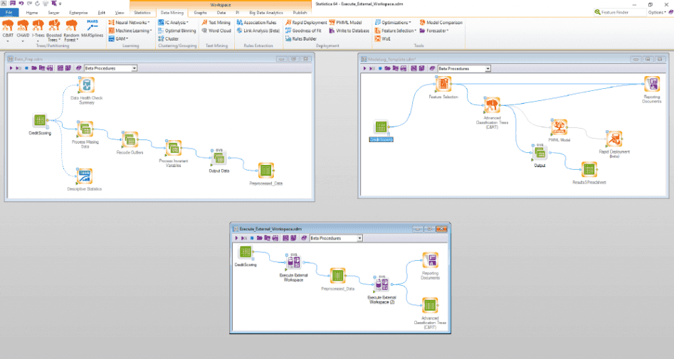
What is this paper talking about
Multi-class Classification
Distinguish 4 class of the ovarian cancer status – control, benign, borderline tumor, invasive cancer
Variables: 2,578 microRNAs
develop a Neural Netwrok to classify patients well
Comparision: serum CA125 level
Traditional ML process
Hyperparameter tuning?
Feature selection?
STATISTICA

Slide 4
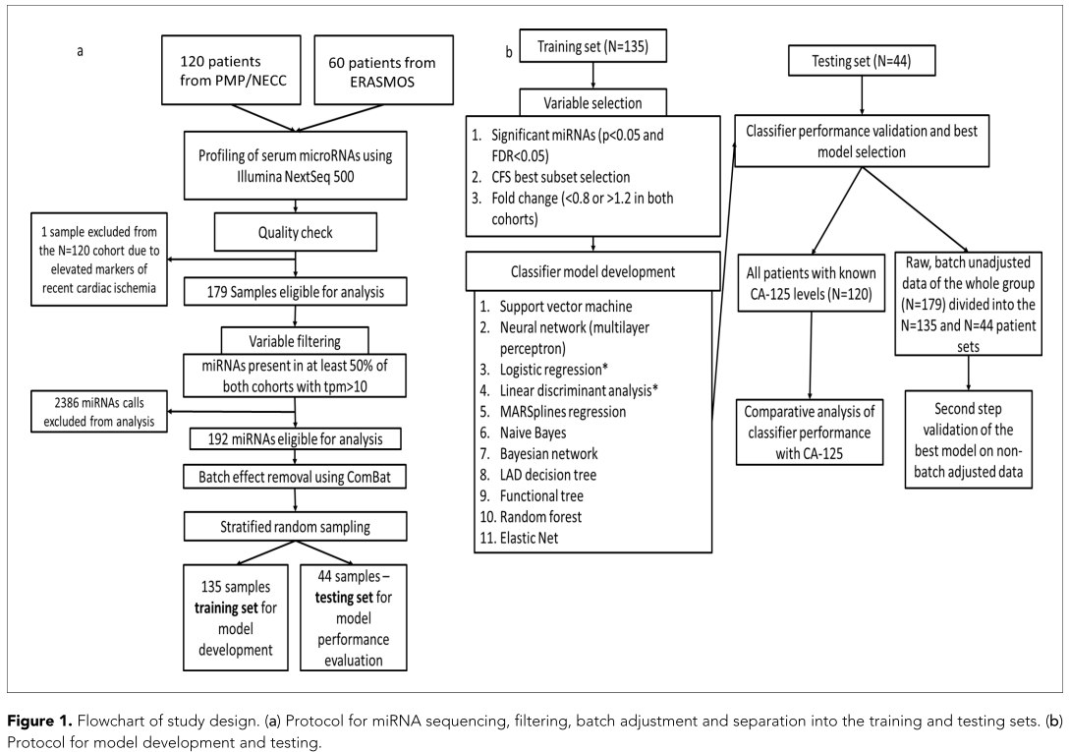
Flowchart of study design

Slide 5
Data Available
GSE94533
Processed RNA-seq data (rawcount & TPM)
Supplement data
elife-28932-supp1-v2.docx
clinical data: Age, Study, Cancer Stage, grade, Histology, CA125 levels
elife-28932-supp6-v2.xlsx
Batch adjusted, log10-transformed miRNA expression data

Slide 6
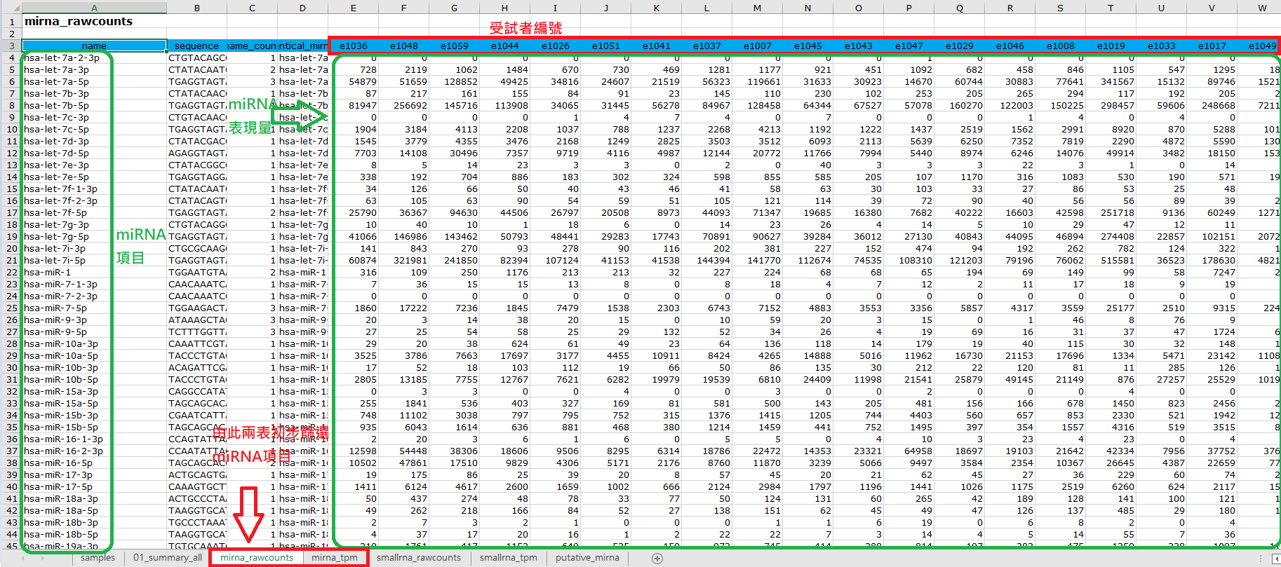
Progressed data Structure

Slide 7
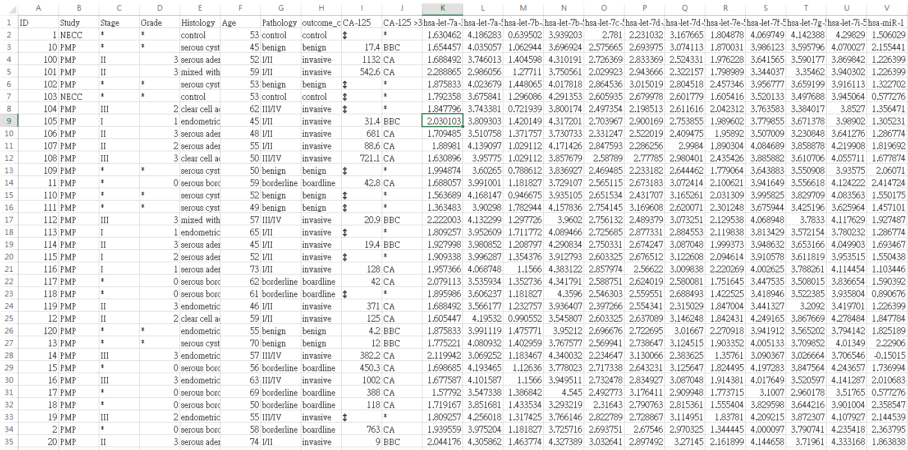
Data Merged

Slide 8
The key point what we got
Why the ML algorithms without boosting ensemble models, such as XGBoost ??
In recent years, XGBoost is a popular tool among a lot of campaigns due to its high performance.
How to deal with hyperparameter tuning ??
Some ML algorithm must tune hyperparameters for performing well, e.g. XGBoost .
If there is a automatic way to select feature??

Slide 9
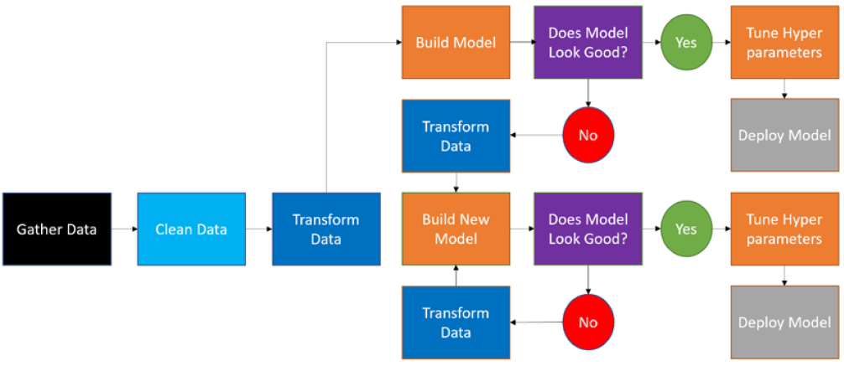
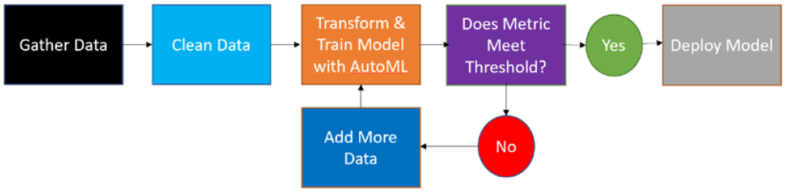
Traditional ML vs AutoML
Traditional
Machine Learning
AutoML

Slide 10
rminer package in r
new automated machine learning (AutoML)
Versions: 1.4.6 / 1.4.5 / 1.4.4
14 classiﬁcation and 15 regression methods
Multi-class Classification
conditional inference tree
generalized linear model (GLM) with elastic net regularization
decision tree
k-nearest neighbor
support vector machine
least squares support vector machine
multilayer perceptron with one hidden layer
random forest
XGBoost
Bagging
adaboost.M1 method
linear discriminant analysis
multinomial logistic regression

Slide 11
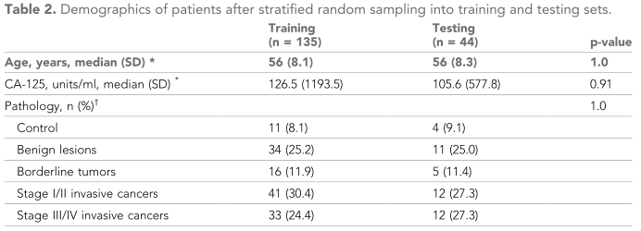
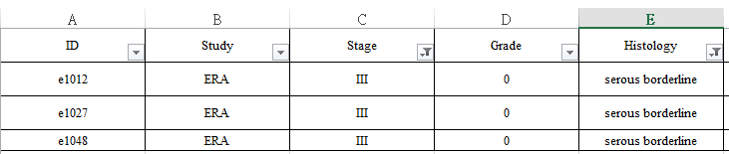
The tricky thing about data
 | Training | testing | P-value
Age(mean) | 57.07 | 56.39 | 0.6029
Pathology |  |  | 0.9862
control | 12 | 3
benign | 34 | 12
borderline | 16 | 6
Stage I/II | 40 | 13
Stage III/IV | 33 | 10
Stage III/IV: 45
Stage III/IV: 46 &
3 patients coding borderline
Grade =0 & Histology written as “borderline” means that those case were checked by examination in the pathology lab

Slide 12
All tool we used
R
openxlsx
rminer
sampling
caret
Python
klearn
sklego
pgmpy.models
pandas
numpy

Slide 13
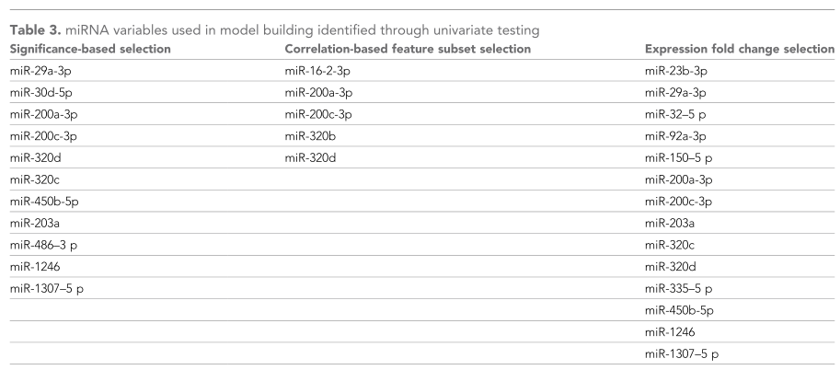
The same features in original models

Slide 14
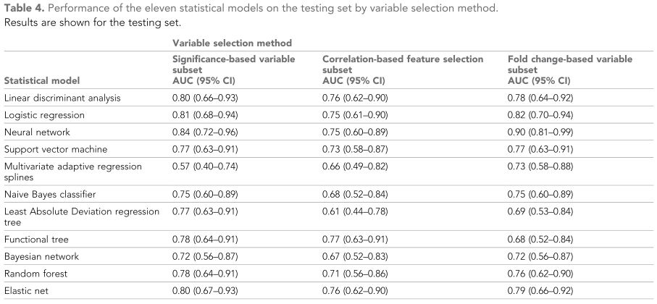
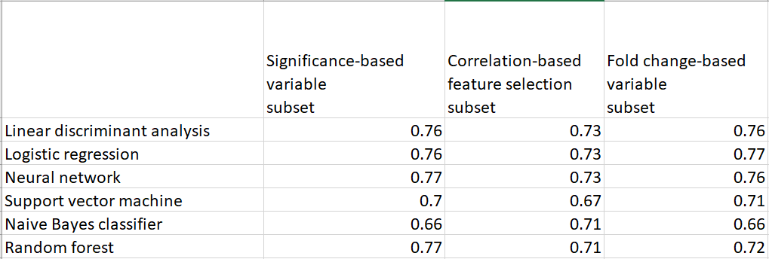
What we found¹ ?
The result Kuan-Hung did has inferior result.
may be due to statistical bias.😢
Our result

Slide 15
What we found² ?
boosting ensemble models may be another good choice .
Model | classification accuracy rate | weighted True Positive rate | weighted F1 score
conditional inference tree(ctree) | 50 | 50 | 38.3
generalized linear model (GLM) with lasso or elasticnet regularization(cv.glmnet) | 54.5 | 54.5 | 40.6
decision tree(dt) | 54.5 | 54.5 | 52.1
k-nearest neighbor(knn) | 50 | 50 | 50.5
support vector machine(svm) | 52.3 | 52.3 | 35.9
least squares support vector machine(lssvm) | 52.3 | 56.8 | 59.1
Neural Network(multilayer perceptron, mlp) | 47.7 | 43.2 | 50.5
random Forest | 52.3 | 56.8 | 45.7
xgboost | 56.8 | 56.8 | 53.1
bagging | 56.8 | 56.8 | 49.7
adaboost.M1 method(boosting) | 56.8 | 61.4 | 53.1
linear discriminant analysis(lda) | 43.2 | 43.2 | 42.6
logistic regression(multinomial) | 47.7 | 47.7 | 47.2
naiveBayes | 43.2 | 43.2 | 44.2

Slide 16
What we found³ ?
We tried to use Recursive Feature Elimination to select miRNA automatically
The result are inconsistent

Slide 17
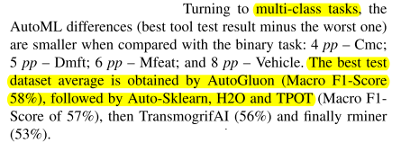
rminer is the best AutoML tool?
For multi-class task:
AutoGluon have the best one.
2nd one are Auto-Sklean, H2O and TPOT
finally: rminer
rminer have an advantage in regression task.
Source: Ferreira, L., et al. A comparison of AutoML tools for machine learning, deep learning and XGBoost. in 2021 International Joint Conference on Neural Networks (IJCNN). 2021. IEEE

Slide 18
Reproducibility
How to document our project? How to maintain our code? How to reproduce our result?
峻福part: data manipulation & run“f_project_tmp.r”
冠宏part: use data “final_dset_combine.csv” & run “test.py”
Teamwork coordination
峻福:research on feature engineering, run AutoML methods which is not implemented by the author, edit Github
冠宏:do some package research, implement the methods mentioned in the paper, edit Github, edit slides

Slide 19

Thank You !

